Slide 1

AI-Based Cyber Security Threats Prediction
An Autonomous Agent for Proactive Network Defense
Project by: Killampalli Yaswanth Vardhan

Slide 2

The Growing Challenge
2.8 billion cyberattacks occurred in 2022 alone, representing a 38% increase from the previous year.
Traditional security systems are fundamentally reactive - they respond to threats after damage has already begun.
Alert Fatigue: Human analysts receive over 10,000 security alerts daily, leading to 95% being ignored or overlooked.

Slide 3



Our Vision: A Proactive & Autonomous Guardian
Introducing an intelligent system that operates as your tireless, 24/7 security sentinel. Our AI-powered agent autonomously monitors network traffic, detects anomalies in real-time, and classifies threats without constant human oversight.
Network Traffic Monitoring
AI Processing
Automated Response
Continuous data stream analysis
Intelligent threat classification
Real-time threat detection
Key Benefit: This frees up human experts to focus on complex, strategic security challenges while our AI handles routine threat detection.

Slide 4
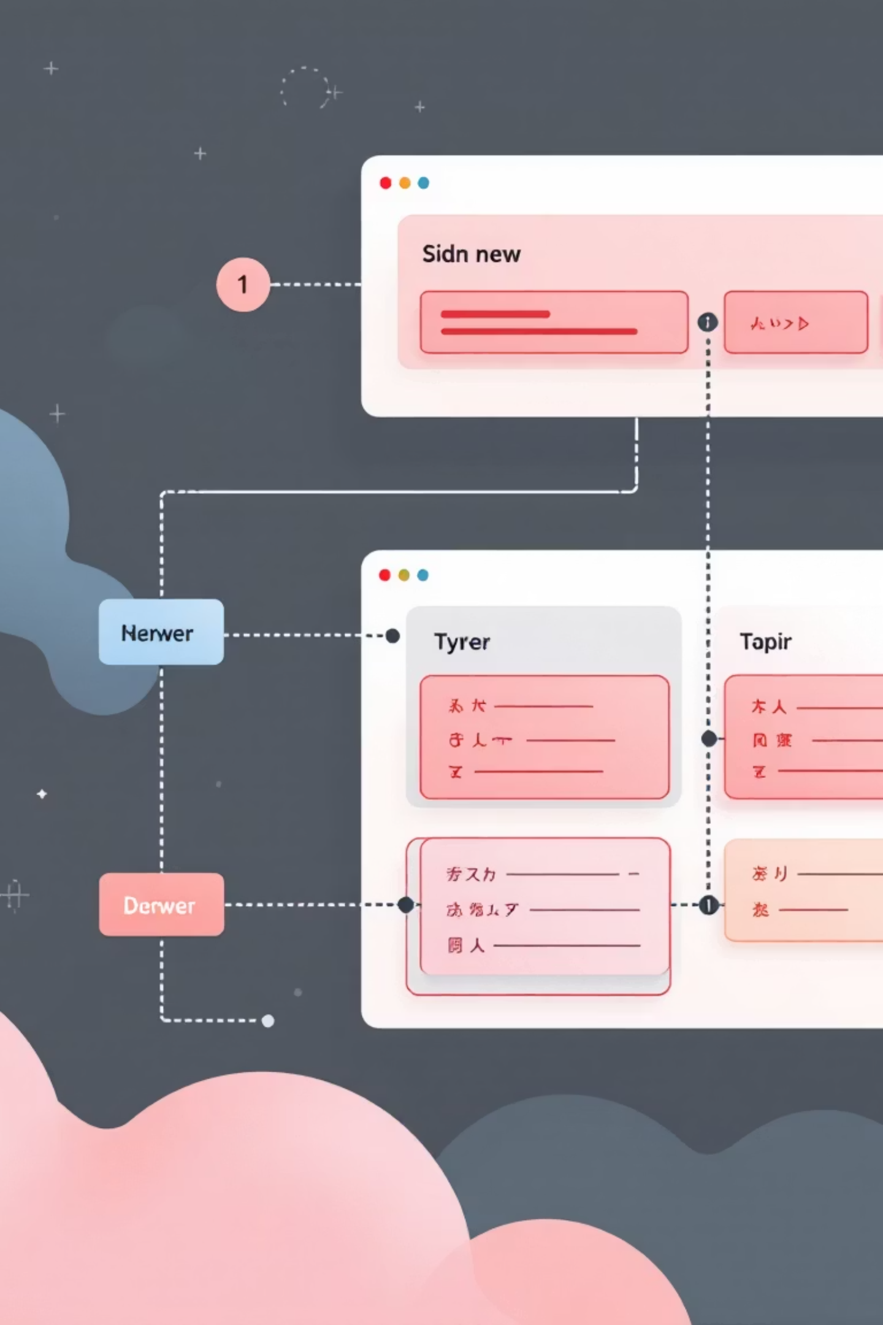
How It's Built: A Modern Three-Tier Architecture
React Frontend
Node.js Backend
Interactive dashboard for visualising network status and threat data using Recharts. The user's window into real-time security insights.
Central nervous system handling API requests, managing business logic, and orchestrating communication between frontend and model server.
Flask Model-Server
Dedicated Python server serving our trained XGBoost model for high-speed, real-time threat predictions with millisecond response times.

Slide 5
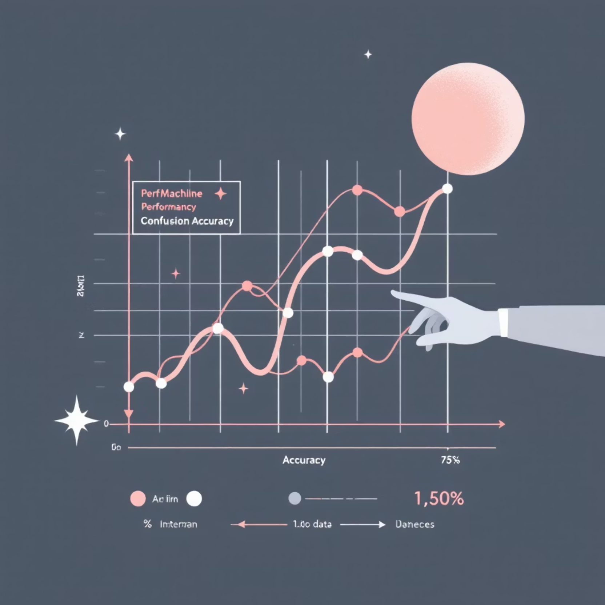
The Predictive Powerhouse
Model Performance
Algorithm: XGBoost (Extreme Gradient Boosting) chosen for exceptional speed and accuracy in real-time environments.
Training Data: Comprehensive CSE-CIC-IDS2018 dataset containing modern network attack patterns and benign traffic samples.
Achieved Accuracy: 95% in threat classification with minimal false positives.

Slide 6
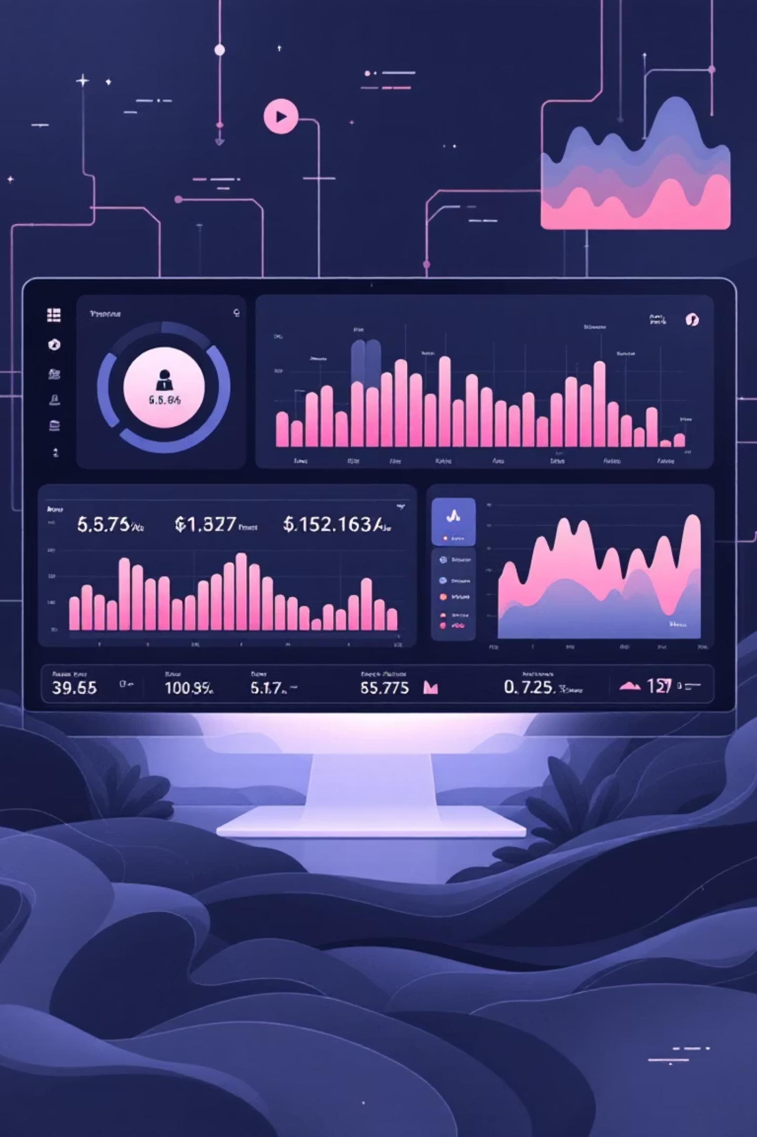



Core Capabilities
Real-time Threat Detection
Analyses network data streams continuously, classifying traffic as benign or malicious within milliseconds of detection.
Interactive Dashboard
Provides clear, intuitive visualisations of network activity, threat patterns, and system performance metrics.
Persistent Threat Logging
All identified threats are automatically logged to Supabase PostgreSQL database for comprehensive auditing and historical analysis.

Slide 7




The Tools That Powered Our Project
Frontend Technologies
Backend & API
React for dynamic user interfaces
Node.js runtime environment
Vite for optimised development
Express.js web framework
Recharts for data visualisation
RESTful API architecture
Axios for API communication
AI & Model Server
Database & Storage
Python with Flask framework
Supabase PostgreSQL
Scikit-learn for preprocessing
Real-time data synchronisation
XGBoost for predictions
Scalable cloud infrastructure
Pandas for data manipulation

Slide 8



See It in Action!
We invite you to explore our live, deployed application and experience the power of AI-driven cybersecurity in real-time.
Experience live threat detection, interactive visualisations, and real-time network monitoring through our intuitive web interface.

Slide 9

The Road Ahead
Challenges Overcome
Future Enhancements
Efficiently processed 2.8 million network traffic records
Automated threat blocking mechanisms
Optimised XGBoost hyperparameters for real-time performance
Ensemble ML models for higher accuracy
Integration with system logs and SIEM platforms
Achieved sub-second response times for threat classification
Advanced threat intelligence feeds

Slide 10

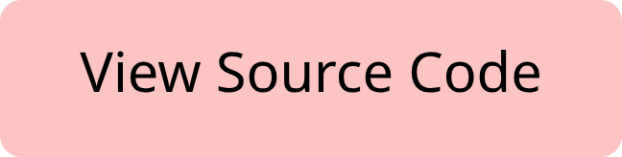
Thank You
Questions?
Explore the complete project on GitHub:
Building the future of autonomous cybersecurity, one prediction at a time.

